Slide 1
Lending Club Case Study
Group Members:
Deepak Rawat
Ganesh Mudkhede

Slide 2
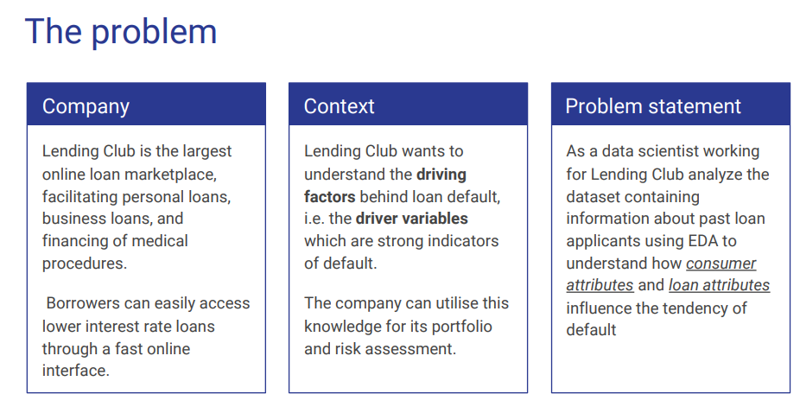

Slide 3
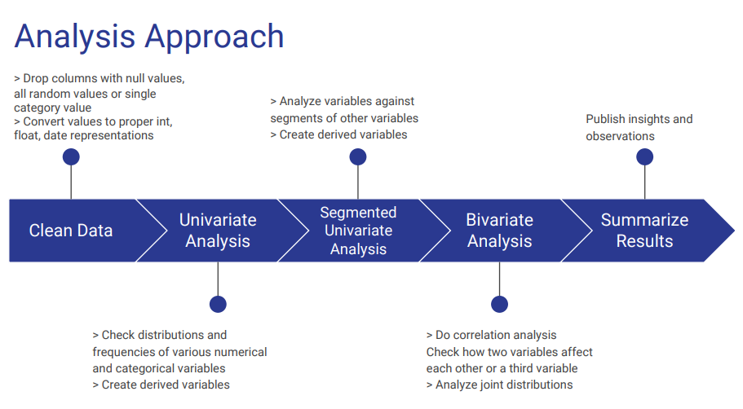

Slide 4
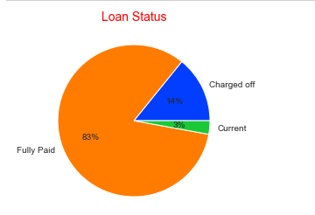
Observations:
14% loans were charged off out of total loan issued.
Loan Status

Slide 5
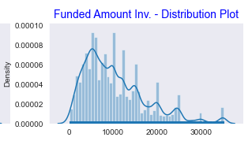
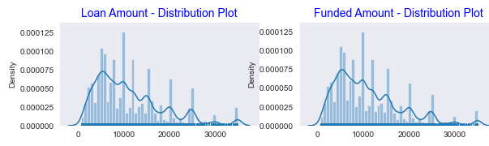
Loan Amount, Funded Amount and Funded Amount Inv.
Observation:
Distribution of amounts for all three looks very much similar.
We will work with only Funded Amount column for rest of our analysis. As it is final amount lended by club.

Slide 6
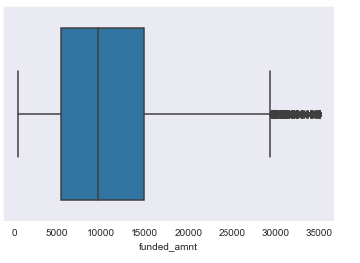
Funded Amount Distribution
Observations:
Majority of loans funded are between $5400 to $15000 (IQR)
Minimum funded amount is $500
Maximum funded amount is $35000

Slide 7
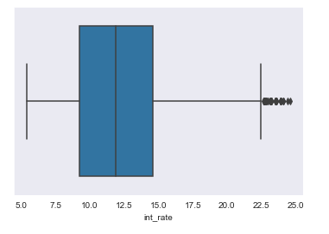
Interest Rate Distribution
Observations:
Majority of loans given at interest rate from 9.25% to 14.59% (IQR)
Minimum interest rate was 5.42%
Maximum interest rate was 24.59%

Slide 8
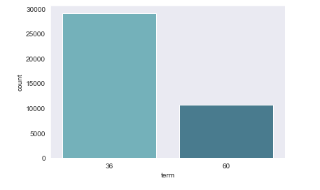
Distribution of Loan Term given to borrower
Observations:
Majority of loans given for period of 30 months

Slide 9
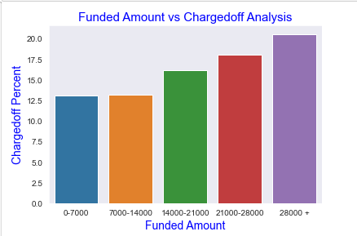
Loan Status vs Funded Amount Categories
Observations:
Funded amount $28000+ has more chances of being charged off.
Funded amount below $14000 has less chances of being charged off.
Notice that with increase in Funded amount, charged off percentage got Increased.

Slide 10
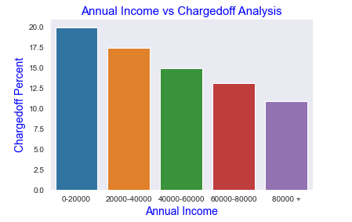
Loan Status vs Annual Income Categories
Observations:
loan given to Income range more than $80000 has less chances of being charged off.
Income range below 20000 has high chances of being charged off.
Notice that with increase in annual income charged off proportion got decreased.

Slide 11
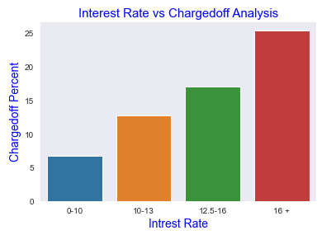
Loan Status vs Interest Rate Category
Observations:
With higher interest rate chances of being charged off increases

Slide 12
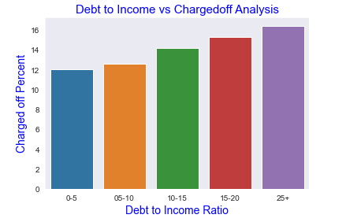
Loan Status vs Debt to Income Categories
Observations:
With increase in debt-to-income ratio chances of being charged off increases

Slide 13
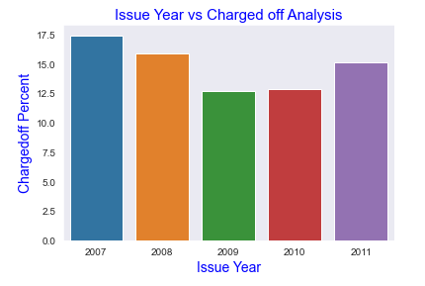
Loan Status vs Issue year
Observations:
Loans issued in 2007 and 2008 had comparatively high charged off percentage.
This may be due to financial crisis happened during that period.

Slide 14
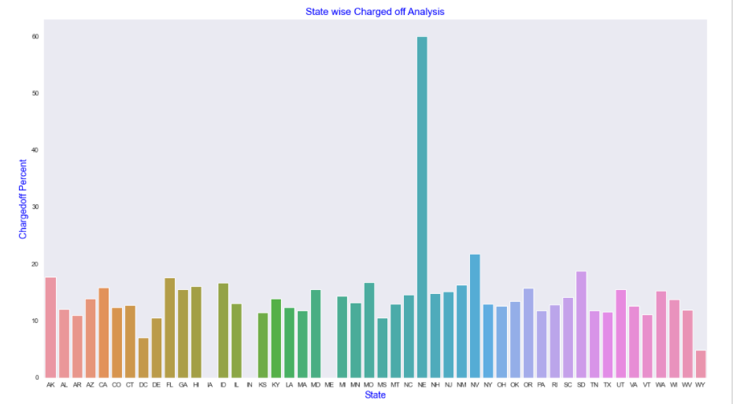
Loan Status vs State
Observations:
State of Nebraska (NE) had high charged off percentage.
This is due to state of Nebraska had a smaller number of loan and out of those 5 numbers 3 got chargedoff.
We can not judge state of Nebraska with this analysis
However NV,AK, SD and FL states showed compartively high number of charged offs than others.

Slide 15
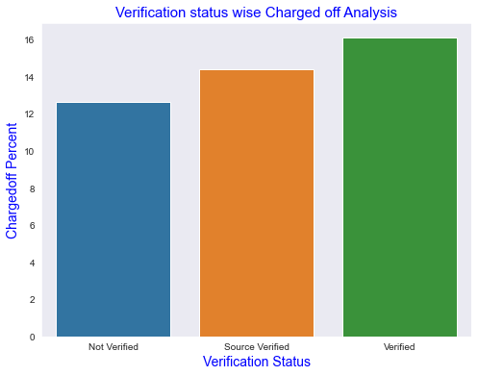
Loan Status vs Verification Status
Observations:
This analysis shows that verified loans have more chances to get charged off which is not convincing.

Slide 16
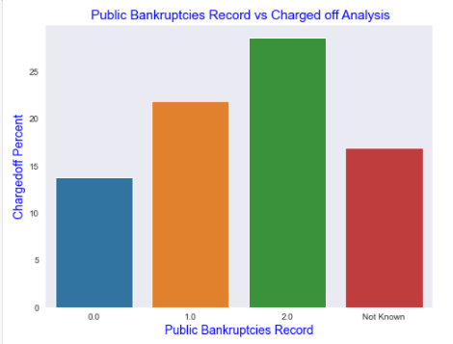
Loan Status vs Public Bankruptcies Record
Observations:
Those who had Public Bankruptcies Record, attracts higher chances of making charged off loans.

Slide 17
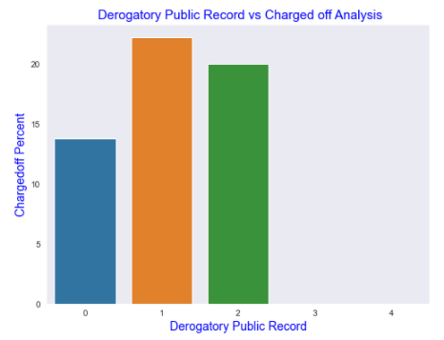
Loan Status vs Derogatory Public Record
Observations:
Those who had 1 or 2 Deogatory public records have higher chances of getting charged off than those who don’t have any Derogatory Public Record.

Slide 18
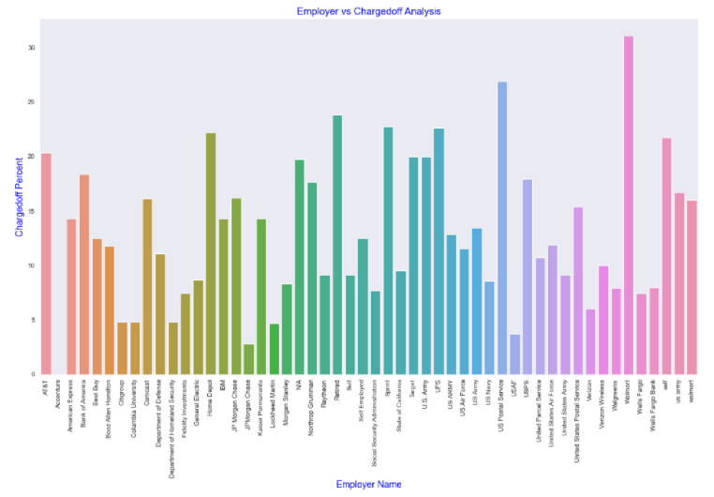
Loan Status vs Employer Title
Observations:
Borrower Working in Accenture showed less chances for default
Borrower Working in Walmart, US Postal Services, Retired etc. showed comparatively high chances for default

Slide 19
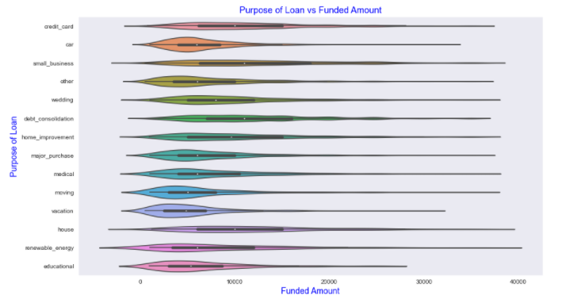
Purpose of loan vs Funded Amount
Observations:
Loan taken for small business purpose, Debt consolidation and Credit card are somewhat evenly distributed as compared to loan taken for other purposes.
Car and vacation loans are mostly lower amount of loan.

Slide 20
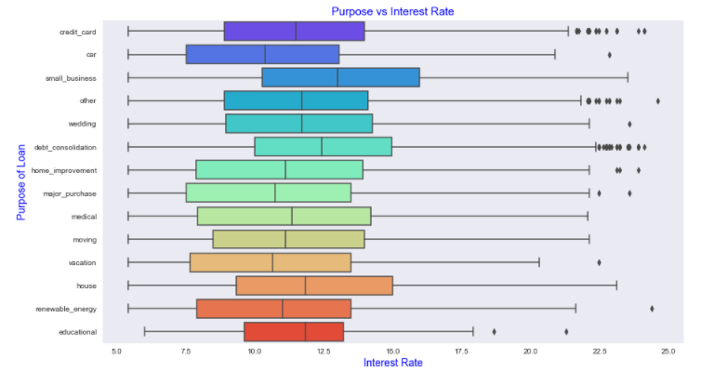
Purpose of loan vs Interest Rate
Observations:
It is clear that average interest rate is highest for small business purpose.
Debt consolidation is 2nd where borrowers had to pay more interest rate.

Slide 21
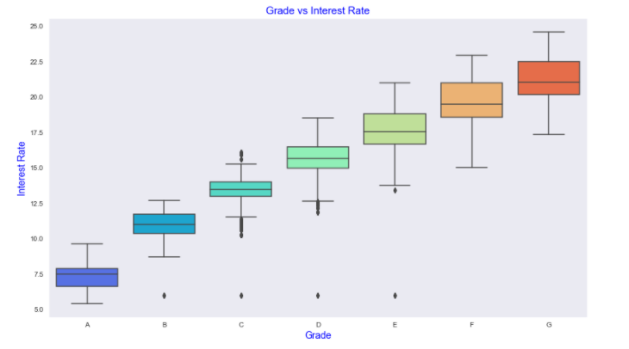
Grade vs Interest Rate
Observations:
The better the borrower's credit grade, the lower the interest rate offered to that borrower.
It is clear that intrest rate is increasing with grades moving from A to F.

Slide 22
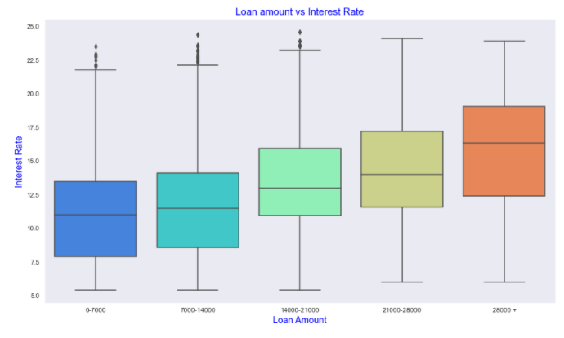
Funded Amount vs Interest Rate
Observations:
It is clear that intrest rate is increasing with increase in funded amount.

Slide 23
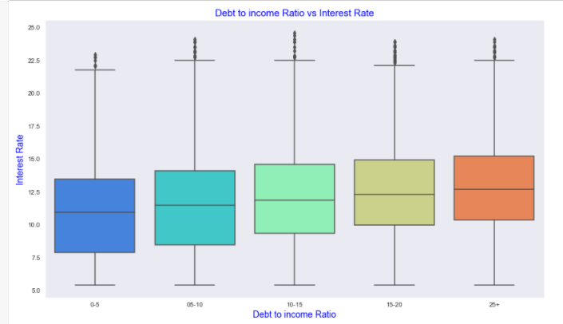
Debt to Income vs Interest Rate
Observations:
If your DTI is low enough you may get a lower interest rate.
There is slight increase in interest rate with increase in DTI.

Slide 24
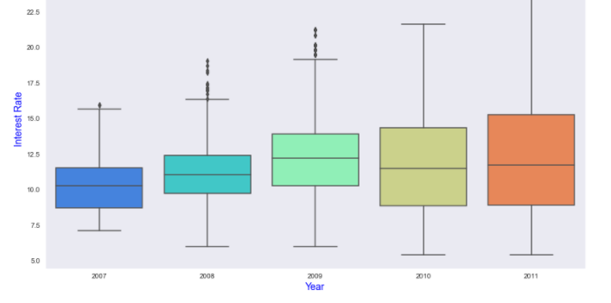
Loan Issue Year vs Interest Rate
Observations:
Lending club had given loan at most varying interest rates to borrower in year 2011.
From 2008 to 2011 Lending club had been consistently increasing range of interest rates offered to borrowers.

Slide 25
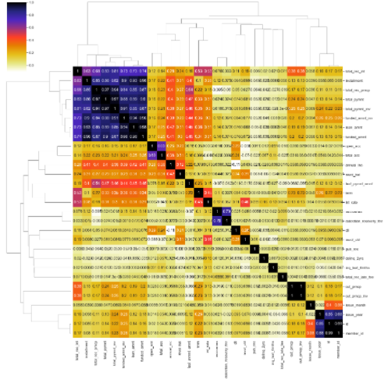
Multivariate Analysis
Observation
Loan amount, investor amount, funding amount are strongly correlated.
Annual income with DTI (Debt-to-income ratio) is negatively correlated.
With increase in annual income dti will certainly reduce.

Slide 26

Thank you

